Slide 1
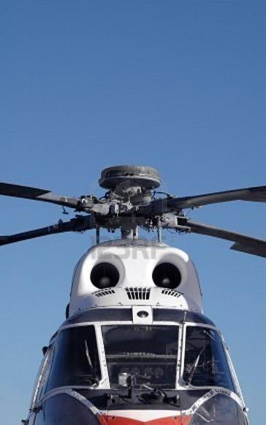
IHST Regional Teams
Webcast on WebEx
7 May 2014
Notes:
Good morning/afternoon ladies and gentlemen.

Slide 2
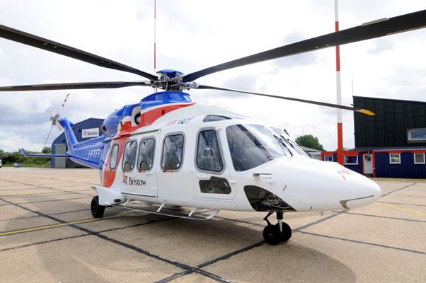
Overview
Introductions & state of each team
Summary of IHSS 2014
Guidance from the ExCom
Helitech International for 2014
Notes:
Here is what I want to cover today.

Slide 3
500 Volunteers in over 40 Countries
Growing each Year
Led by teams in the US, Canada and Europe, the IHST now has teams in:
Australia
Brazil
the Commonwealth of Independent States
India
Japan
the Middle East & North Africa
The IHST is working to establish effective teams in
Asia
Mexico and the Spanish-speaking countries in Central and South America
New Zealand
South Africa
3
Notes:
3
In the order listed here, starting with the US Helicopter Safety Team representative, please state who is on this webcast and briefly describe your team’s current efforts and any collaboration or support needs you may have.

Slide 4
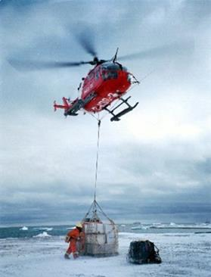
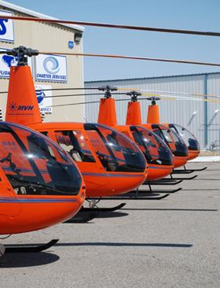
Notes:
At the end of this year’s Heli-Expo, there was an International Helicopter Safety Symposium (IHSS) at the same venue – the Anaheim Convention Center. There were XXX participants from a cross-section of our industry and some press representatives.

Slide 5
2014 International Helicopter Safety Symposium
Presentations available at http://www.ihst.org/
Keynote speech by Kurt Robinson
Awesome talk by Julia Link
Panel on safety culture
Regional team reports and panel session with OEMs
Notes:
The presentations made during IHSS 2014 are now available on the IHST’s website. They include a really great speech by Kurt Robinson of Robinson Helicopters. In describing the crash of an R66, killing four people after inadvertent entry of IMC, Kurt cautioned the audience that his company’s helicopters are built for VFR flight and said “if you fly an R66 into IMC you will die.” Julia Link also gave a great talk about her autorotation into downtown Honolulu, Hawaii in an R22. Her story confirmed that pilots must be trained to have habit-strength safe responses for emergencies. She said it took her some time to consciously appreciate that her engine had failed, but her hands had already lowered the collective and set the right autorotation speed with the cyclic. “I didn’t think, my hands just did it.”
There was an important panel session where regional team members said they need people to do the work, funding to get the work out, venues to connect with small operators and engagement from national aviation authorities. The OEMs promised to engage the IHST’s regional teams in all their customer events.

Slide 6
Guidance from the IHST ExCom
Funding
Strive for local funding
Leverage local manufacturing events
Funding requests must follow the policy at http://www.ihst.org/portals/54/IHST%20FUNDING%20POLICY%20FINAL.pdf
Focus on preventing fatalities
Notes:
In order to give its full support to the United States Federal Aviation Administration’s (FAA) new Rotorcraft Safety Initiative (RSI), the Executive Committee for the International Helicopter Safety Team (IHST) is asking its regional teams to establish an additional focus on the steps that can be taken to prevent fatalities in helicopter accidents. This direction means that regional teams will be focusing on the types of accidents that most frequently result in fatalities and the most cost-effective measures to improve helicopter crash survivability. Such measures are likely to include helmets, crash resistant fuel systems, crash-worthy seats with upper torso restraints, seatbelt airbag systems, deployable emergency locator transmitters and other measures that can be retrofitted to the existing global helicopter fleet.
The added focus on reducing fatalities does not change the IHST’s long-term vision of an international civil helicopter community with zero accidents. Though the regional teams’ focus on fatalities may produce some new safety recommendations specific to the causes of fatal accidents or to crash survivability, the IHST’s high level safety recommendations are unlikely to change. Those high level recommendations regard safety management systems, training, systems & equipment (including health & usage monitoring systems and flight data monitoring systems), and maintenance practices. The IHST’s analyses of over 1,000 accidents worldwide could be a valuable reference for the FAA RSI. Over 500 volunteers around the world stand ready to assist the FAA RSI and would welcome any specific requests from the FAA RSI.

Slide 7
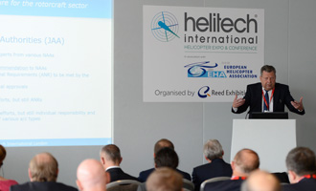
Helitech International Amsterdam – 14-16 October 2014
Notes:
The European Helicopter Safety Team and International Helicopter Safety Team, in conjunction with the Global Helicopter Flight Data Monitoring Steering Group are proud to present the second edition of the Safety Workshop during Helitech International in Amsterdam on the 14th through the 16th of October.
As they did last September in London, these workshops will offer a range of hot topics including flight training, HUMS, FDM, risk management, safety culture and more. Please go to this event if you can and encourage other operators and your customers to attend.

Slide 8
Questions?
Notes:
Are there any questions?

Slide 9
Thank you!
Notes:
Again, thank you for your continued support. Our industry will never achieve its full potential unless we improve the public perception of helicopter safety. With the press lumping all accidents in all types of helicopters for all types of causes, amplifying the public distrust in helicopter safety, every accident is our accident. I ask that now, more than ever, you see the value of the IHST in helping to improve the public perception of helicopter safety by reducing the number of accidents in all industry sectors around the world. The IHST is contributing a lot to that effort and your continued support is vital to achieving the vision of zero accidents.

