Slide 1
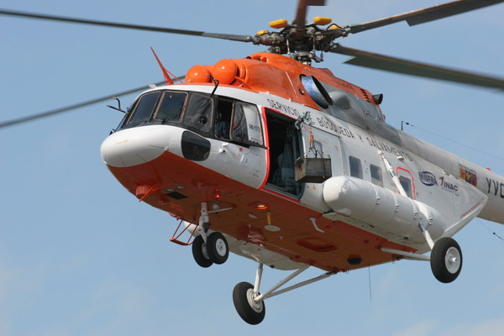
Honeywell Helicopter RMUs

Slide 2

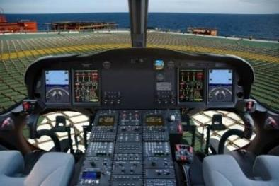
Honeywell Aerospace
Developing innovative safety products, driving the modernization of global air traffic management, revolutionizing combat technology and committed to improving operational efficiencies.
Phoenix, AZ headquarters
38,000 employees at nearly 100 locations
$12B revenues
(2012)
Safety
Businesses:
Defense & Space
Air Transport & Regional
Business & General Aviation
Efficiency
Operational
Readiness
Situational
Awareness
Products:
Integrated avionics
Propulsion engines
Aircraft and engine systems
Full-service solutions for airliners, B&GA aircraft, military aircraft and spacecraft.
Mission
Performance
Budget
Optimization

Slide 3
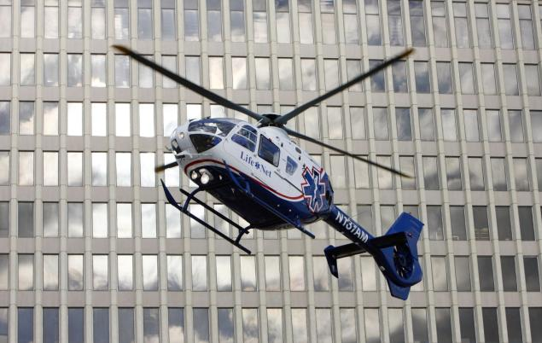
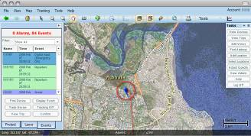
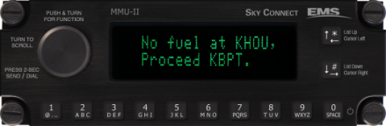
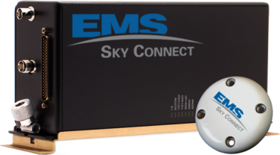

Sky Connect Hardware & Data Solutions
Mapping Applications
MMU-II Mission Management Unit
Voice, Messaging &
Tracking Applications
FLEET Tracking Dialer
Notes:
3
3
The basic Sky Connect hardware package consists of:
Transceiver- Radio, Modem, and processing
MMU-II –Cockpit interface for text messaging, dialing, and data acquisition for messaging
Fleet Tracking Dialer also called 11-P dialer for the 11 preset numbers that can be associated with the 11 position switch, also includes programmable event switches to trigger event messages
The optional ground map that shows where the aircraft is located and its track
The most important part of the system from a revenue perspective is the invisible part – the AIRTIME Contract, just like a cell phone contract there are data plans for Sky Connect and the user is charged a fixed and recurring fee for usage of the system.

Slide 4
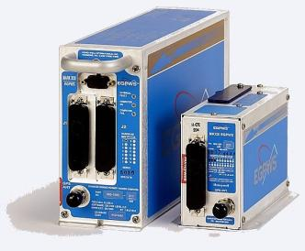
Helicopter EGPWS Overview
Mk XXII
Mk XXI
TAWS TSO C-151b Class A
Expanded Sensor Interface
Mid-size to Large Helicopters
Radar Altimeter Installations
Expanded Alerting Call-outs
154 x 76 x 261 mm3
1.77kg
TAWS TSO C-151b Class B
Limited Sensor Interface
Small to Mid-Size Helicopters
No Radar Altimeter Installations
Basic Alerting Call-outs
100 x 69 x 159 mm3
0.72 kg
Common Features
Regional Terrain Database
Small, Lightweight, Flange Mount
Terrain Display Output
Internal GPS Card
Notes:
This section is focused on the Helicopter EGPWS Safety Solutions.

Slide 5
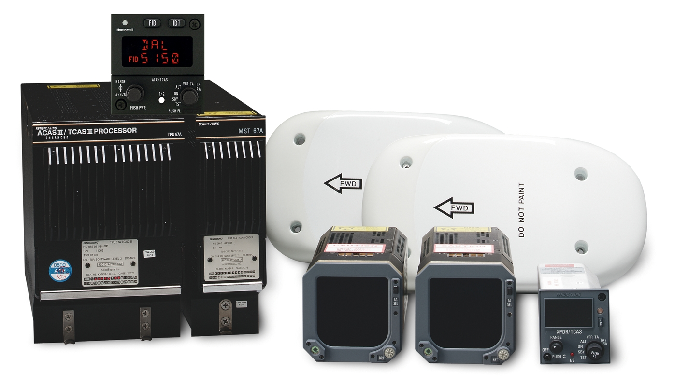
Helicopter TCAS Overview
  Meets all TCAS II change 7.0 / ACAS II requirements
  High reliability … low life-cycle cost, low maintenance. TCAS field diagnostics software
  Elementary and Enhanced Surveillance / ADS-B Out
  Diversity and Non-Diversity Installations
  Change 7.1 release in 2013
  Over 10,000 installations on fixed wing and rotary wing aircraft.
  Honeywell invented TCAS II / ACAS II, which is the basis of all Collision Avoidance systems today

Slide 6
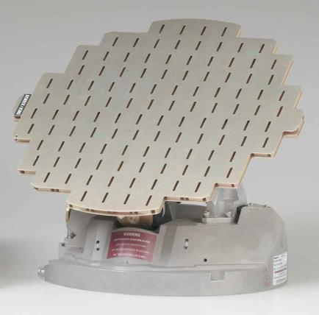
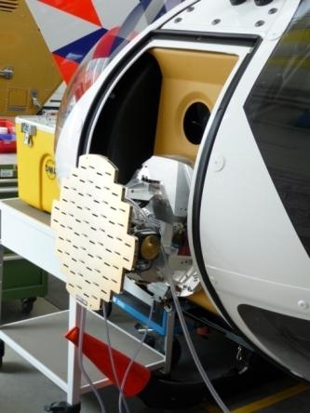
Helicopter Weather Radar Overview
RDR 2100
  6 kW Transmitter
  Meets Weather Detection requirements for small, weight sensitive aircraft
  No remote-mounted electronics, Receiver and Transmitter are contained in the base
  Low Price, Good Value for basic Weather Radar
  Full Featured
    Vertical Profile
    4-color Weather
    Target Alerting
    Antenna Stabilization
  Highest Number of Installations on Helicopters
  Helicopter Installations Include:
  AW 109
  AS 350/355/365
  B 212
  EC 135/145/155
Notes:
The RDR 2000 and RDR 2100 family is the smallest, lightest, and least expensive system in the Honeywell Radar portfolio. It is best suited for general aviation aircraft and utility helicopters.
The system consists of what you see in the picture and a display with integrated controls.
All the electronics are contained within the base of the Advanced Receiver Transmitter ( also known as the ART), which is mounted on the nose of the aircraft.
Speaking of being located on the nose of the aircraft; mounting the Weather Radar Antenna systems on the centerline of the aircraft allows the system to determine the position of weather relative to the heading of the aircraft. You will see Radar system capabilities described with a scan consisting of a number of degrees, such as 120 degrees, which is plus and minus 60 degrees of center.
The picture shows an RDR 2000 being installed on an EC 135/145 at the Eurocopter factory.

Slide 7
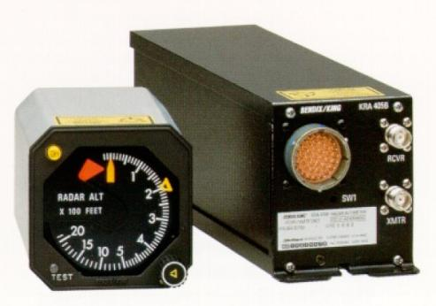
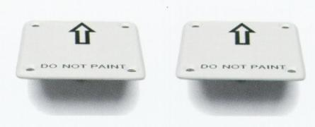
Helicopter Radar Altimeter Overview
Superior Performance
  -10 to +2500 ft AGL indication
  +/- 5 ft or +/- 5% accuracy from 0-500 ft AGL
  Analog and digital (A429) outputs
  DH indication and trip output
Easy to Install
  On-ground zero height calibration
  Rigid, shock or direct-frame mounting
Reduced Size and Weight
  Reduced size (33%) and weight (50%) compared to KRA 405
  Weight of 1.36kg including rack
Reliable
  Decreased number of circuit cards from 7 to 2
  Fault monitoring and pilot initiated self-test
  Forward fit on numerous civilian, military and rotary wing airframes

Slide 8
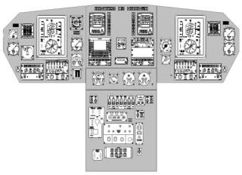
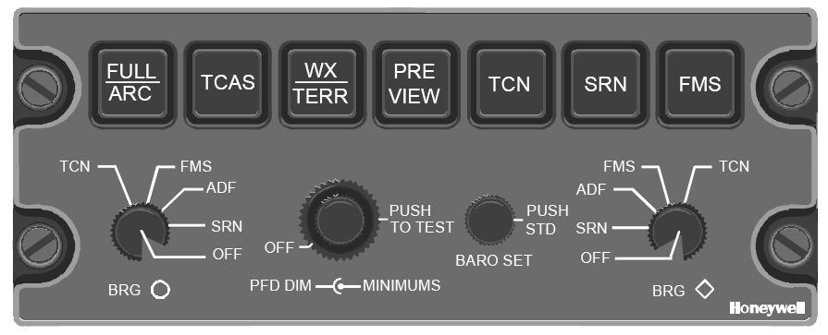
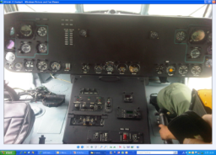
Mi-17 CDS/R - Value Proposition
Increased Safety ($120k/year)
  Enhanced Situational Awareness through intuitive display of information
  Active Matrix LCD
  Industry recognized safety features
Reduced Cost of Ownership (savings vary by configuration)
  Reduced maintenance costs
  Higher reliability
  Increased resale value
  Reduced insurance rates
Mission Capable ($33k/year)
  NVG compatible
  Helicopter certified
  Capable to interface with wide range of sensors (IRS, TACAN, TCAS)
  IFR capable / weather dispatch
  Future enhancements
Original Cockpit
>$150k in Total Savings per Year

